Slide 1

Dense Passage Retrieval for Open-Domain Question Answering
Vladimir Karpukhin, Barlas Oguz, Sewon Min, Patrick Lewis,
Ledell Wu, Sergey Edunov, Danqi Chen, Wen-tau Yih
EMNLP 2020
김봉민

Slide 2
Introduction
김봉민

Slide 3

Part 1
Introduction
Open-domain question answering is a task that answers factoid questions using a large collection of documents.
(1) A context retriever first selects a small subset of passages where some of them contain the
answer to the question
(2) A machine reader can thoroughly examine the retrieved contexts and identify correct
answer.
Retrieval in open-domain QA is usually implemented using TF-IDF or BM25 (sparse vectors)
- Synonyms or paraphrases that consist of completely different tokens may still be mapped to
vectors close to each other.
Conversely, the dense, latent semantic encoding is complementary to sparse representations by design.
1

Slide 4
Part 1
Introduction
Q. Who is the bad guy in lord of the rings?
P. Sala Baker is best known for portraying the villain Sauron in the Lord of the Rings trilogy
A term-based system would have difficulty retrieving such a context, while a dense retrieval system would be able to better match “bad guy” with “villain” and fetch the correct context.
Dense encodings are also learnable by adjusting the embedding functions, which provides additional flexibility to have a task-specific representation.
However, it is generally believed that learning a good dense vector representation needs a large number of labeled pairs of question and contexts.
1

Slide 5
Part 1
Introduction
Dense retrieval methods have thus never be shown to outperform TF-IDF/BM25 for open-domain QA before ORQA (Lee et al., 2019), which proposes a sophisticated inverse cloze task (ICT) objective, predicting the blocks that contain the masked sentence, for additional pretraining.
Problems
First, ICT pretraining is computationally intensive and it is not completely clear that regular sentences are good surrogates of questions in the objective function.
Second, because the context encoder is not fine-tuned using pairs of questions and answers, the corresponding representations could be suboptimal.
1

Slide 6
Part 1
Introduction
We address the question : can we train a better dense embedding model using only pairs of questions and passages (or answers), without additional pretraining?
By leveraging the now standard BERT pretrained model and a dual-encoder architecture, we focus on developing the right training scheme using a relatively small number of question and passage pairs.
Our final solution : the embedding is optimized for maximizing inner products of the question and relevant passage vectors, with an objective comparing all pairs of questions and passages in a batch.
Contribution :
(1) We demonstrate that with the proper training setup, simply fine-tuning the question and
passage encoders on existing question-passage pairs is sufficient to greatly outperform
BM25.
(2) We verify that, in the context of open-domain question answering, a higher retrieval
precision indeed translates to a end-to-end QA accuracy.
1

Slide 7
Dense Passage Retriever (DPR)
김봉민

Slide 8
Part 2
Dense Passage Retriever
We focus our research in this work on improving the retrieval component in open-domain QA.
Given a collection of M text passages, the goal of our DPR is to index all the passages in a low-dimensional and continuous space, such that it can retrieve efficiently the top k passages relevant to the input question for the reader at run-time.
5

Slide 9
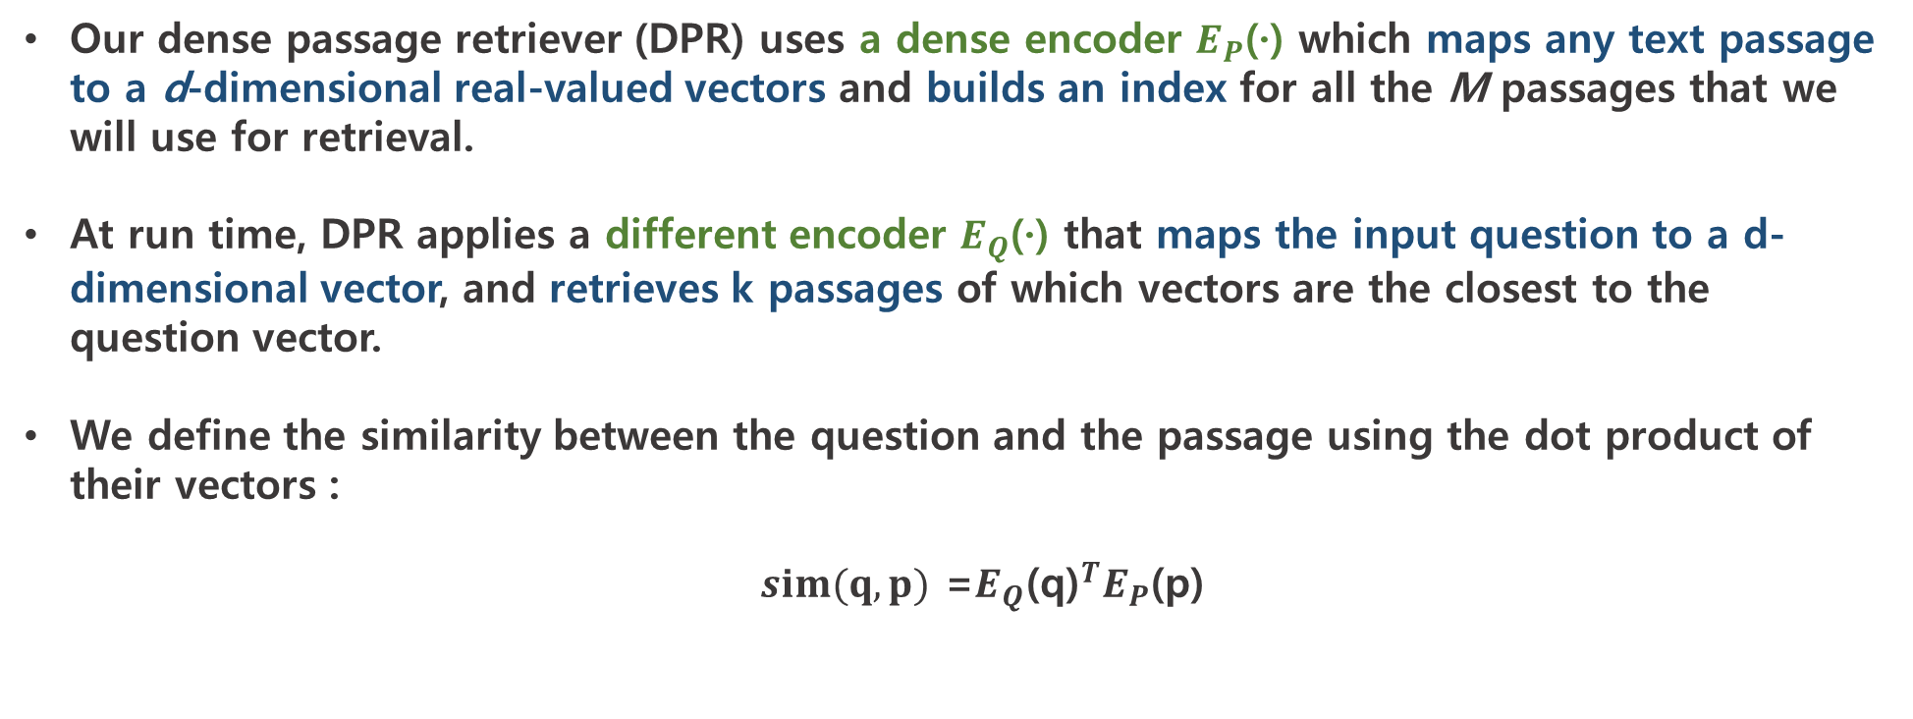
Part 2.1
Overview
Our dense passage retriever (DPR) uses a dense encoder $E_{P}$(·) which maps any text passage to a d-dimensional real-valued vectors and builds an index for all the M passages that we will use for retrieval.
At run time, DPR applies a different encoder $E_{Q}$(·) that maps the input question to a d-dimensional vector, and retrieves k passages of which vectors are the closest to the question vector.
We define the similarity between the question and the passage using the dot product of their vectors :
$sim(q,p)$ =$E_{Q}{\text{(}\text{q}\text{)}}^{T}E_{P}$(p)
6

Slide 10
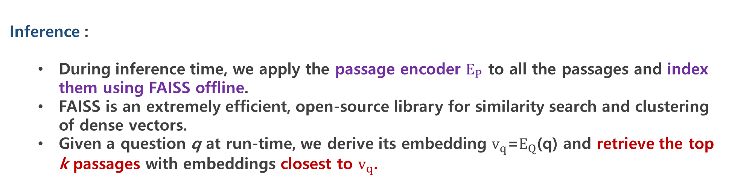
Part 2.1
Overview
Encoders :
Although in principle the question and passage encoders can be implemented by any neural networks.
In this work we use two independent BERT networks and take representation at the [CLS] token as the output, so d = 768.
Inference :
During inference time, we apply the passage encoder $E_{P}$ to all the passages and index them using FAISS offline.
FAISS is an extremely efficient, open-source library for similarity search and clustering of dense vectors.
Given a question q at run-time, we derive its embedding $v_{q}$=$E_{Q}$(q) and retrieve the top k passages with embeddings closest to $v_{q}$.
6

Slide 11
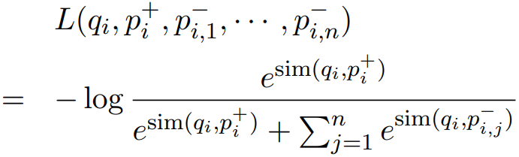
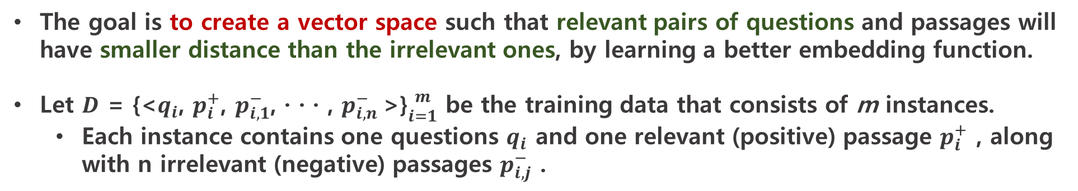
Part 2.2
Training
The goal is to create a vector space such that relevant pairs of questions and passages will have smaller distance than the irrelevant ones, by learning a better embedding function.
Let $D$ = {<$q_{i}$, $p_{i}^{+}$, $p_{i,1}^{−}$, · · · , $p_{i,n}^{−}$>}${m \atop i=1}$ be the training data that consists of m instances.
Each instance contains one questions $q_{i}$ and one relevant (positive) passage $p_{i}^{+}$ , along with n irrelevant (negative) passages $p_{i,j}^{−}$ .
We optimize the loss function as the negative log likelihood of the positive passage :
7

Slide 12
Part 2.2
Training
Positive and negative passages :
For retrieval problems, it is often the case that positive examples are available explicitly, while negative examples need to be selected from an extremely large pool.
For instance, passages relevant to a question may be given in a QA dataset, or can be found using the answer.
All other passages in the collection, while not specified explicitly, can be viewed as irrelevant by default.
In practice, how to select negative examples is often overlooked but could be decisive for learning a high-quality encoder.
We consider three different types of negatives :
(1) Random : any random passage from the corpus
(2) BM25 : top passages returned by BM25 which don’t contain the answer but match most
question tokens
(3) Gold : positive passages paired with other questions which appear in the training set.
Our best model uses gold passages from the same mini-batch and one BM25 negative passage.
7

Slide 13
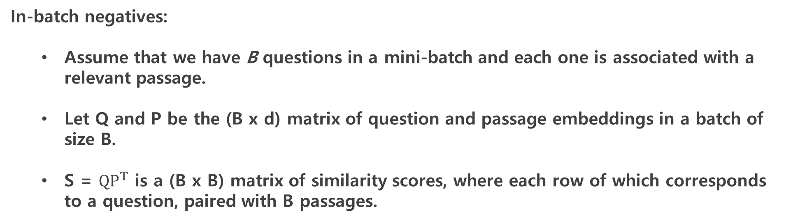
Part 2.2
Training
In-batch negatives:
Assume that we have B questions in a mini-batch and each one is associated with a relevant passage.
Let Q and P be the (B x d) matrix of question and passage embeddings in a batch of size B.
S = $QP^{T}$ is a (B x B) matrix of similarity scores, where each row of which corresponds to a question, paired with B passages.
7

Slide 14
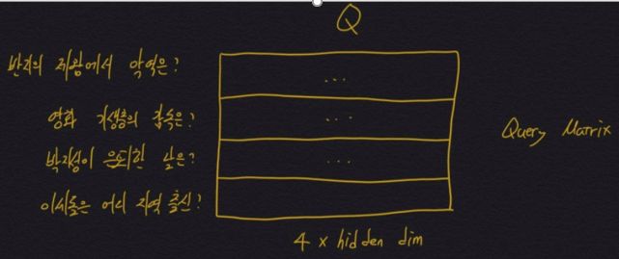
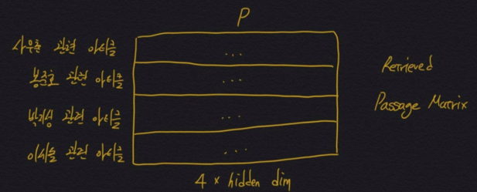
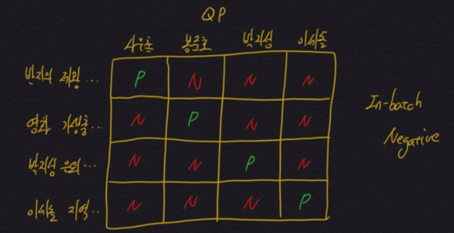
Part 2.2
Training
7

Slide 15
Experiments Setup
김봉민

Slide 16
Part 3.1
Wikipedia Data Pre-processing
We use the English Wikipedia dump from Dec. 20, 2018 as the source documents for answering questions.
We split each article into multiple, disjoint text blocks of 100 words as passages, serving as our basic retrieval units.
7

Slide 17
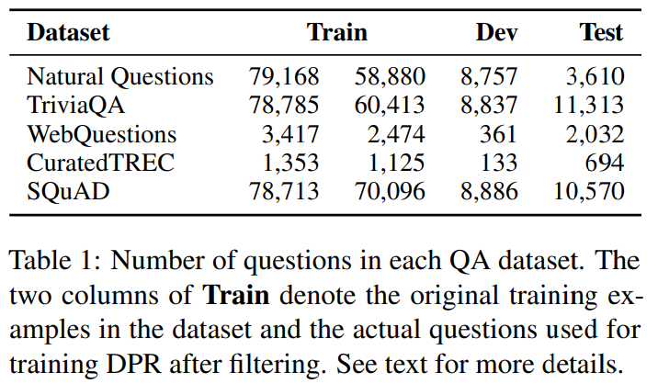
Part 3.2
Question Answering Datasets
We use the five QA datasets.
Natural Questions (NQ)
Trivia QA
Web Questions
Curated TREC
SQuAD v1.1
7

Slide 18
Experiments : Passage Retrieval
김봉민

Slide 19
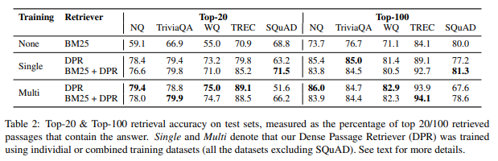
Part 4
Experiments : Passage Retrieval
Table 2 compares different passage retrieval systems on five QA datasets, using the top-k accuracy.
With the exception of SQuAD, DPR performs consistently better than BM25 on all datasets.
BM25+DPR, using a linear combination of their scores as the new ranking function.
We obtain two initial sets of top-2000 passages based on BM25 and DPR, respectively, and rerank the union of them using BM25(q,p) + λ·sim(q,p) as the ranking function.
7

Slide 20
Part 4
Experiments : Passage Retrieval
We conjecture that the lower performance on SQuAD is due to two reasons.
First : the annotators wrote questions after seeing the passage. As a result, there is a high lexical overlap between passages and questions, which gives BM25 a clear advantage.
Second : the data was collected from only 500+ Wikipedia articles and thus the distribution of training examples is extremely biased.
7

Slide 21
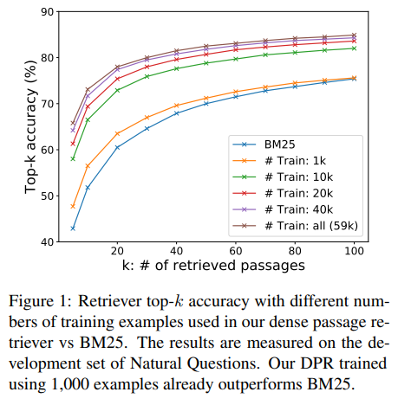
Part 4
Experiments : Passage Retrieval
We explore how many training examples are needed to achieve good passage retrieval performance.
Figure 1 illustrates the top-k retrieval accuracy with respect to different numbers of training examples, measured on the development set of NQ.
7

Slide 22
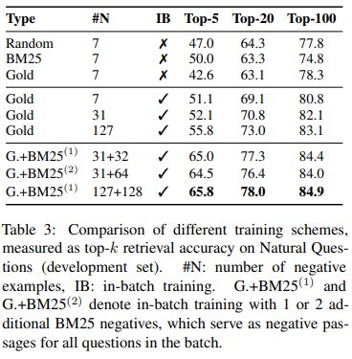
Part 4
Experiments : Passage Retrieval
We test different training schemes on the development set of NQ and summarize the results in Table 3.
7

Slide 23
Part 4
Experiments : Passage Retrieval
Cross-dataset generalization:
Can it still generalize well when directly applied to a different dataset without additional fine-tuning?
To test the cross-dataset generalization, we train DPR on NQ only and test it directly on the smaller WebQuestions and CuratedTREC datasets.
We find that DPR generalizes well, with 3-5 pointes loss from the best performing fine-tuned model in top-20 retrieval accuracy (69.9/86.3 vs 75.0/89.1 for WebQuestions and TREC, respectively), while still greatly outperforming the BM25 baseline (55.0/70.9).
7

Slide 24
Part 4
Experiments : Passage Retrieval
Run-time Efficiency:
The main reason that we require a retrieval component for open-domain QA is to reduce the number of candidate passages that the reader needs to consider, which is crucial answering user’s questions in real-time.
With the help of FAISS in-memory index for real-valued vectors, DPR can be made incredibly efficient, processing 995.0 questions per second, returning top 100 passages per question.
In contrast, BM25/Lucene processes 23.7 questions per second per CPU thread.
On the other hand, the time required for building an index for dense vectors is much longer.
Building the FAISS index on 21-million vectors on a single server takes 8.5 hours.
Building an inverted index using Lucene takes only about 30 minutes in total.
7

Slide 25
Experiments : Question Answering
김봉민

Slide 26
Part 5
Experiments : Question Answering
End-to-end QA System:
Besides the retriever, our QA system consists of a neural reader that outputs the answer to the question.
Given the top k retrieved passages, the reader assigns a passage selection score to each passage. In addition, it extracts an answer span from each passage and assigns a span score.
The best span from the passage with the highest passage selection score is chosen as the final answer.
7

Slide 27
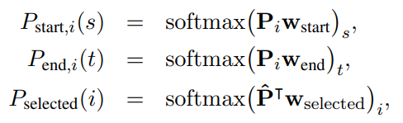
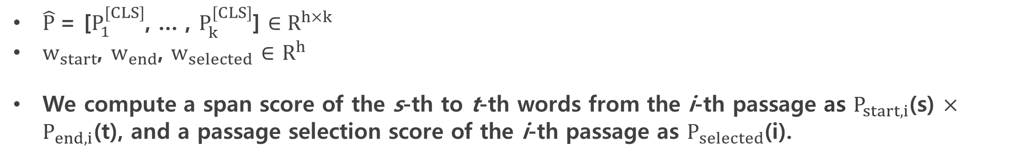
Part 5
Experiments : Question Answering
End-to-end QA System:
$P_{i}$ $∈ R^{L×h}$(1 $≤$i $≤$ k)
Be a BERT representation for the i-th passage, where L is the maximum length of the passage and h the hidden dimension,
The probabilities of a token being the starting/ending positions of an answer span and a passage being selected are defined as :
$\hat{P}$= [$P_{1}^{[CLS]}$, … , $P_{k}^{[CLS]}$] $∈R^{h×k}$
$w_{start}$, $w_{end}$, $w_{selected}$ $∈$ $R^{h}$
We compute a span score of the s-th to t-th words from the i-th passage as $P_{start,i}$(s) $×$ $P_{end,i}$(t), and a passage selection score of the i-th passage as $P_{selected}$(i).
7

Slide 28
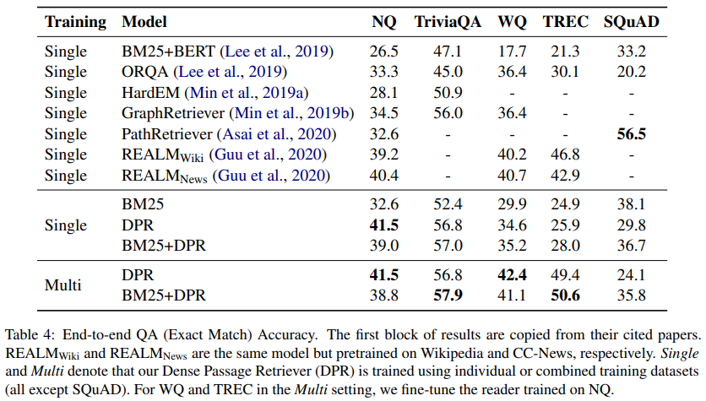
Part 5
Experiments : Question Answering - Results
7

Slide 29
Part 6
Conclusion
In this work, we demonstrated that dense retrieval can outperform and potentially replace the traditional sparse retrieval component in open-domain question answering.
As a result of improved retrieval performance, we obtained new state-of-the-art results on multiple open-domain question answering benchmarks.
7

